Slide 1
Co (ne)budeme od laboratoře potřebovat při hodnocení KV rizika?
Michal Vrablík
Česká společnost pro aterosklerózu
Centrum preventivní kardiologie
3. interní klinika 1. LF UK a VFN, Praha

Slide 2
Lipidové a nelipidové biomarkery rizika ASKVO
Celkový cholesterol
HDL-cholesterol
LDL-cholesterol
Triglyceridy
Apolipoprotein AI
Apolipoprotein B
Lipoprotein (a)
TG/HDL-c
Log (TG/HDL-c) – AIP
Non-HDL-cholesterol
LDL particle number
VLDL-c, VLDL-TG
RLP-cholesterol
hsCRP
FGF21
TnI
kolagen
Genetické markery
albumin
leukocyty
Imunofenotypizace periferních leukocytů
Poměr neutrofily/lymfocyty
TMAO
Natriuretické peptidy
Hydroxyanthranilová kyselina
…

Slide 3
Nové SCORE: více kohort, modernější data, méně nadhodnocení, extenze do vyššího věku, základní parametr: non-HDL-C
SCORE 2
SCORE OP

Slide 4
Lipoproteiny v plazmě
HDL IDL VLDL
LDL
Apo-B obsahující lipoproteiny
Anti- aterogenní
lipoproteiny ?
Aterogenní lipoproteiny
Non-HDL-C = celkový cholesterol-HDL-C

Slide 5
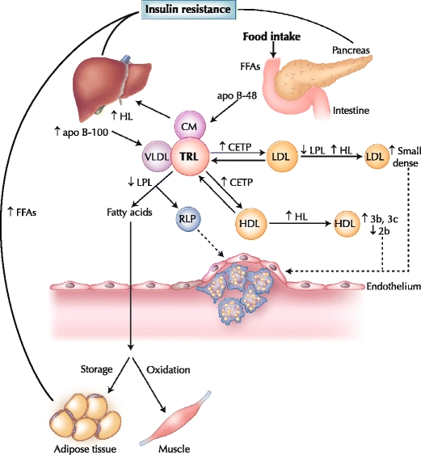
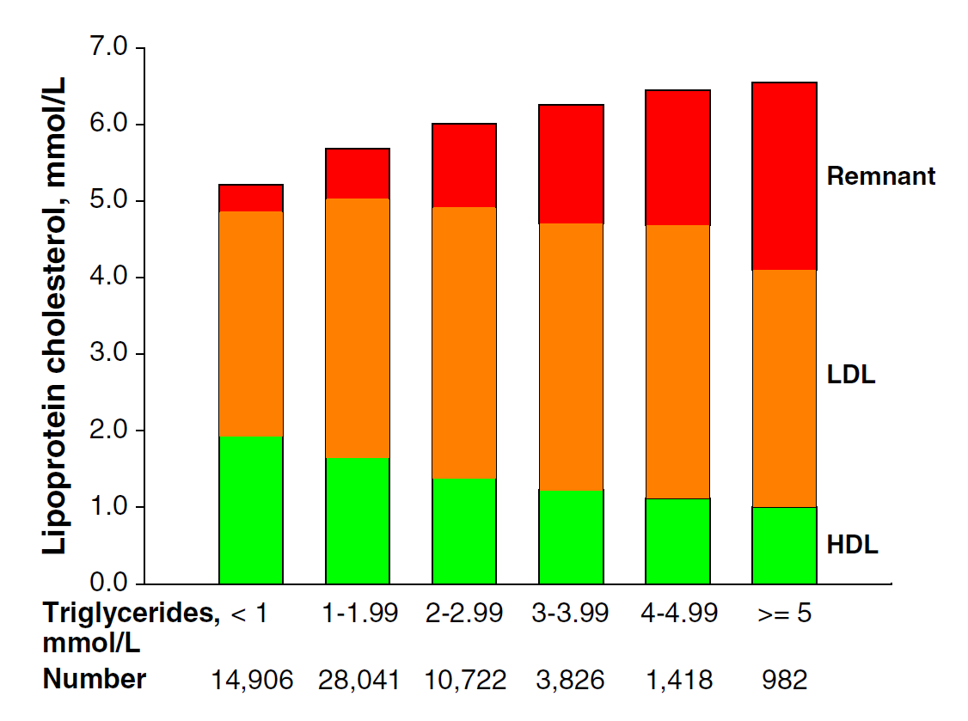
Posprandiální (protrahovaná) hyperlipemie: významný aterogenní potenciál
Enkhmaa et al. Curr Diab Rep (2010) 10:61–69
Varbo et al. Pharmacology and Therapeutics 2014
Notes:
Postprandial lipoprotein metabolism in diabetes. Insulin resistance plays a central role in the development of diabetic dyslipidemia. Under normal physiologic conditions, insulin suppresses lipolysis from adipose tissue and hepatic very low density lipoprotein (VLDL) production. However, hyperinsulinemia in the postprandial state and insulin resistance in type 2 diabetes initiates a dyslipidemic triad of high triglyceride, low high-density lipoprotein (HDL) cholesterol and high small, dense low-density lipoprotein (LDL) levels. Prolonged residence of triglyceride-rich lipoproteins (TRLs) in the circulation promotes the transfer of HDL or LDL cholesteryl esters for triglyceride, mediated by cholesteryl ester transfer protein (CETP). LDL can undergo hydrolysis by hepatic lipase (HL) or lipoprotein lipase (LPL), which hydrolyzes triglycerides from the core of LDL, resulting in production of smaller, denser particles. Moreover, triglyceride-enriched HDL particles become smaller, denser (HDL 3b and 3c) and are more rapidly catabolized, contributing to low plasma HDL in insulin resistance and type 2 diabetes. apo apolipoprotein; CM chylomicron; FFA free fatty acid; RLP remnant lipoprotein

Slide 6
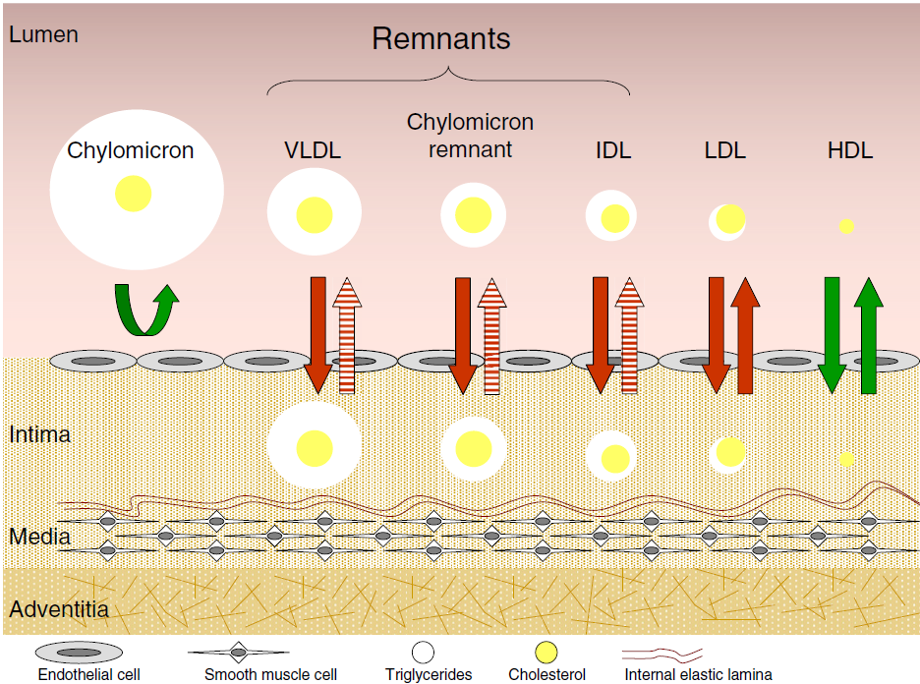
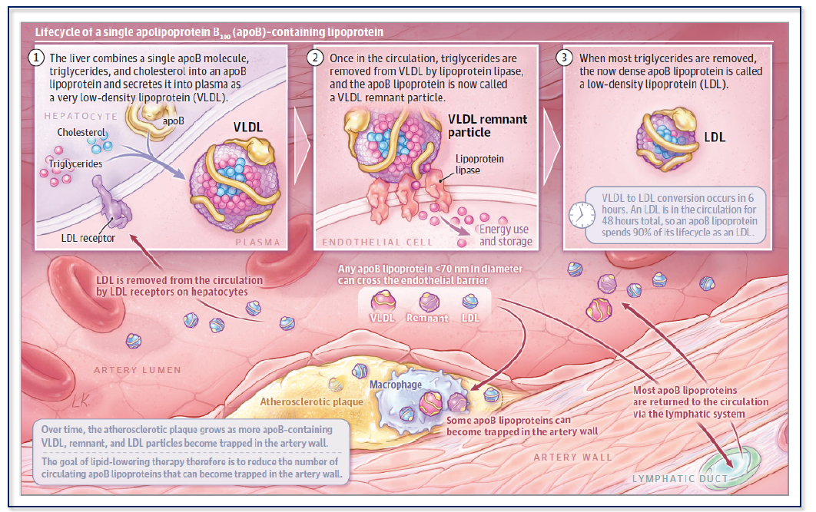
Aterogenní lipoproteiny: nejen LDL
Non-HDL-C = celkový cholesterol-HDL-C
(RLP-C= celkový cholesterol – HDL-c- LDL-C)
Varbo et al. Pharmacology and Therapeutics 2014, Ference, Kastelein, Catapano, JAMA 2020

Slide 7
Retence RLP v subendoteliálním prostoru
Ginsberg H et al. European Heart Journal (2021) 00, 1–21

Slide 8
RLP se typicky zmnožují postprandiálně a zvyšují riziko
Ginsberg H et al. European Heart Journal (2021) 00, 1–21

Slide 9
Nejvhodnější ukazatele aterogenicity sérových lipidů
± ↑ LDL-C
↑ Small, dense LDL
Aterogenní
lipidová
trias
↑ Non-HDL-C
↑ apoB
↑ TG-rich Lp(TRLs) (nalačno i postprandiálních)
↑ Velkých VLDL částic
↓ HDL-C
Small, dense HDL
PP=postprandial
Austin et al. Circulation 1990
Notes:
Lipid Management in Clinical Practice - Section 1
9
SLIDE 2:
ATHEROGENIC LIPOPROTEIN PROFILE
The lipid profile of patients with type 2 diabetes and of those with the Metabolic Syndrome (MetS) is characterized by the concurrent presence of qualitative as well as quantitative lipoprotein abnormalities: low levels of HDL-C (<50 mg/dl in women, < 40 mg/dl in men), increased triglycerides (TG >150 mg/dl), and prevalence of LDL particles that are smaller and denser than normal. This lipid phenotype has been defined as Atherogenic Lipoprotein Profile (1). Interestingly, elevated LDL-C level is not typical of type 2 diabetes nor MetS.
This lipid phenotype is also present in women with Polycystic Ovarian Syndrome (POS) and is a feature of the most common genetic form of dyslipidemia: Familial Combined Hyperlipidemia (FCHL)
REFERENCES
1 Austin MA, Breslow JL, Hennekens CH, Buring JE, Willett WC, Krauss RM. Low-density lipoprotein subclass patterns and risk of myocardial infarction. JAMA. 1988;260:1917-1921.

Slide 10
Rizikové kategorie nově

Slide 11
Cílové hodnoty plazmatických lipidů a lipoproteinů podle ESC/EAS 2019
Riziko | Nízké | Středně zvýšené | Vysoké | Velmi vysoké | Extrémní*
LDL-C (mmol/l) | <3,0 | < 2, 6 a snížení o nejméně 50 % hodnot před léčbou | < 1, 8 a snížení o nejméně 50 % hodnot před léčbou | < 1, 4 a snížení o nejméně 50 % hodnot před léčbou | < 1, 0
Non- HDL-C (mmol/l)^{x} | <3,8 | < 3, 4 | < 2, 6 | < 2, 2 | < 1, 8
apoB (g/l) | - | < 1, 0 | < 0, 8 | < 0, 65 | -

Slide 12
Každé snížení LDL-c o 1 mmol/l znamená…
Vliv snížení LDL-c na cévní příhody podle CTT meta-analýzy
Všechny cévní příhody
Koronární příhody
Koronární revaskularizace
CMP (všechny)
Ischemická CMP
Kryptogenní CMP
Úmrtí na KVO
Úmrtí na ICHS
Ostatní KVO úmrtí
27 Statin Trials
174,149 Patients
CTT Collaborators. Lancet 2012; 380: 581

Slide 13
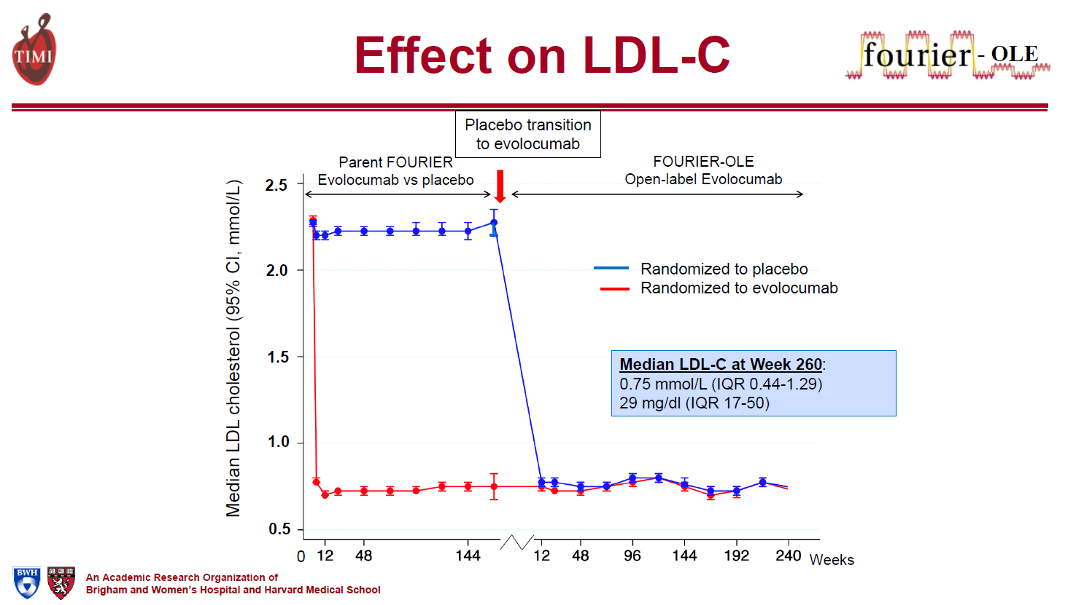

Slide 14
Měřit nebo počítat (koncentraci LDL-C), to je oč tu běží…
• Friedewald: LDL-C=TC-HDL-C-(TG/5)
• Hattori: LDL-C=(0.94×TC)-(0.94×HDL-C)-(0.19×TG)
• Anandaraja: LDL-C=(0.9×TC)-(0.9×TG/5)-28
• Vujovic: LDL-C=TC-HDL-C-(TG/6.58)
• Chen: LDL-C=(TC-HDL-C)×0.9-(TG×0.1)
• de Cordova: LDL-C=0.7516×(TC-HDL-C)
Clin Chem. 1972;18:499–502
Lipids Health Dis. 2010;9:52
Clin Chem Lab Med. 2001;39:426–431.
Lipids Health Dis. 2010;9:27
Atherosclerosis. 1998;138:289–299
Notes:
Background and Objectives
Low-density lipoprotein cholesterol (LDL-C), an established cardiovascular risk factor, can be generally determined by calculation from total cholesterol, high-density lipoprotein cholesterol, and triglyceride concentrations. The aim of this study was to compare LDL-C estimations using various formulas with directly measured LDL-C in a community-based group and hospital-based group among the Korean population.
Subjects and Methods
A total of 1498 participants were classified into four groups according to triglyceride concentrations as follows: <100, 100–199, 200–299, and ≥300 mg/dL. LDL-C was calculated using the Friedewald, Chen, Vujovic, Hattori, de Cordova, and Anandaraja formulas and directly measured using a homogenous enzymatic method. Pearson's correlation coefficients, intraclass correlation coefficients (ICC), Passing & Bablok regression, and Bland-Altman plots were used to evaluate the performance of six formulas.
Results
The Friedewald formula had the highest accuracy (ICC=0.977; 95% confidence interval 0.974-0.979) of all the triglyceride ranges, while the Vujovic formula had the highest accuracy (ICC=0.876; 98.75% confidence interval 0.668–0.951) in people with triglycerides ≥300 mg/dL. The mean difference was the lowest for the Friedewald formula (0.5 mg/dL) and the percentage error was the lowest for the Vujovic formula (30.2%). However, underestimation of the LDL-C formulas increased with triglyceride concentrations.
Conclusion
The accuracy of the LDL-C formulas varied considerably with differences in triglyceride concentrations. The Friedewald formula outperformed other formulas for estimating LDL-C against a direct measurement and the Vujovic formula was suitable for hypertriglyceridemic samples; it could be used as an alternative cost-effective tool to measure LDL-C when the direct measurement cannot be afforded

Slide 15
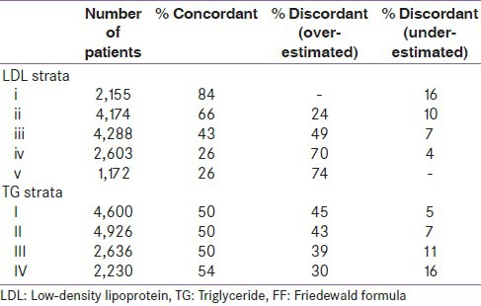
Přesnost LDL-C výpočtu klesá se stoupajícími TG, ale není dostatečná ani v běžných koncentracích LDL-C
Nepoužívat Friedewaldovu formuli
při TG > 2, 26 mmol/l
anebo
LDL-C < 1, 8 a > 3,4 mmol/l
Indian J Endocrinol Metab. 2014 Jul-Aug; 18(4): 502–504
Notes:
We compared low-density lipoprotein (LDL)-cholesterol calculated by FF to directly measured LDL in a laboratory database of 14,620 lipid profile samples from south India.
Results:
LDL by FF correlated with directly measured LDL with correlation coefficient of 0.89 with the best correlation seen in TG levels 100-150. Higher level of TG (>200) underestimates the LDL calculated by FF particularly at LDL values <70 mg/dl. On the other hand, LDL is overestimated by FF in more than 70% of cases at LDL levels >130 mg/dl.
Conclusion:
We suggest repeating the LDL by direct assay techniques particularly in patients with TG >200 and when LDL <70 or >130. This helps in correctly stratifying the coronary artery diseases’ (CADs’) risk and goals of treatment.
Keywords: Friedewald formula, LDL cholesterol, triglyceride

Slide 16
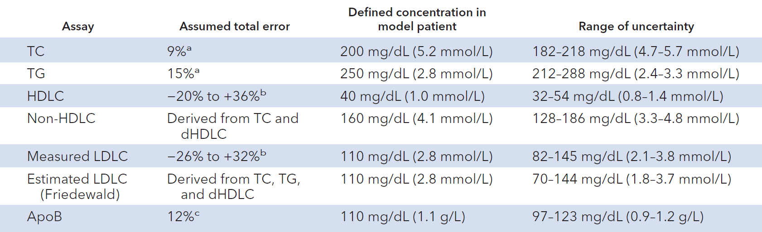
Variabilita stanovení LDL-C je také realita
Clinical Chemistry 64:7, 1006–1033 (2018)

Slide 17
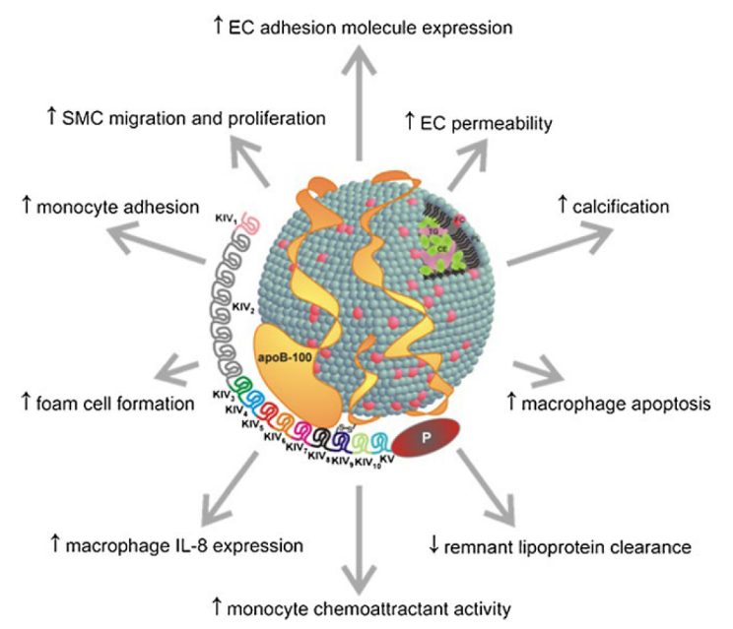
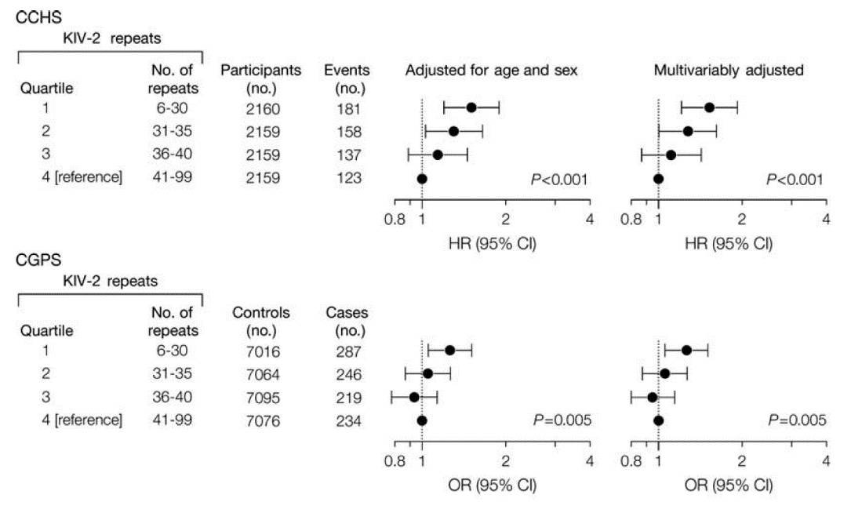
Lipoprotein (a)
Kamstrup et al, Copenhagen Heart Study, JAMA 2009

Slide 18
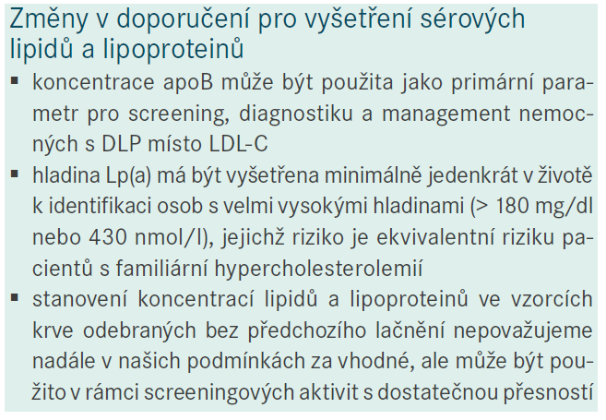
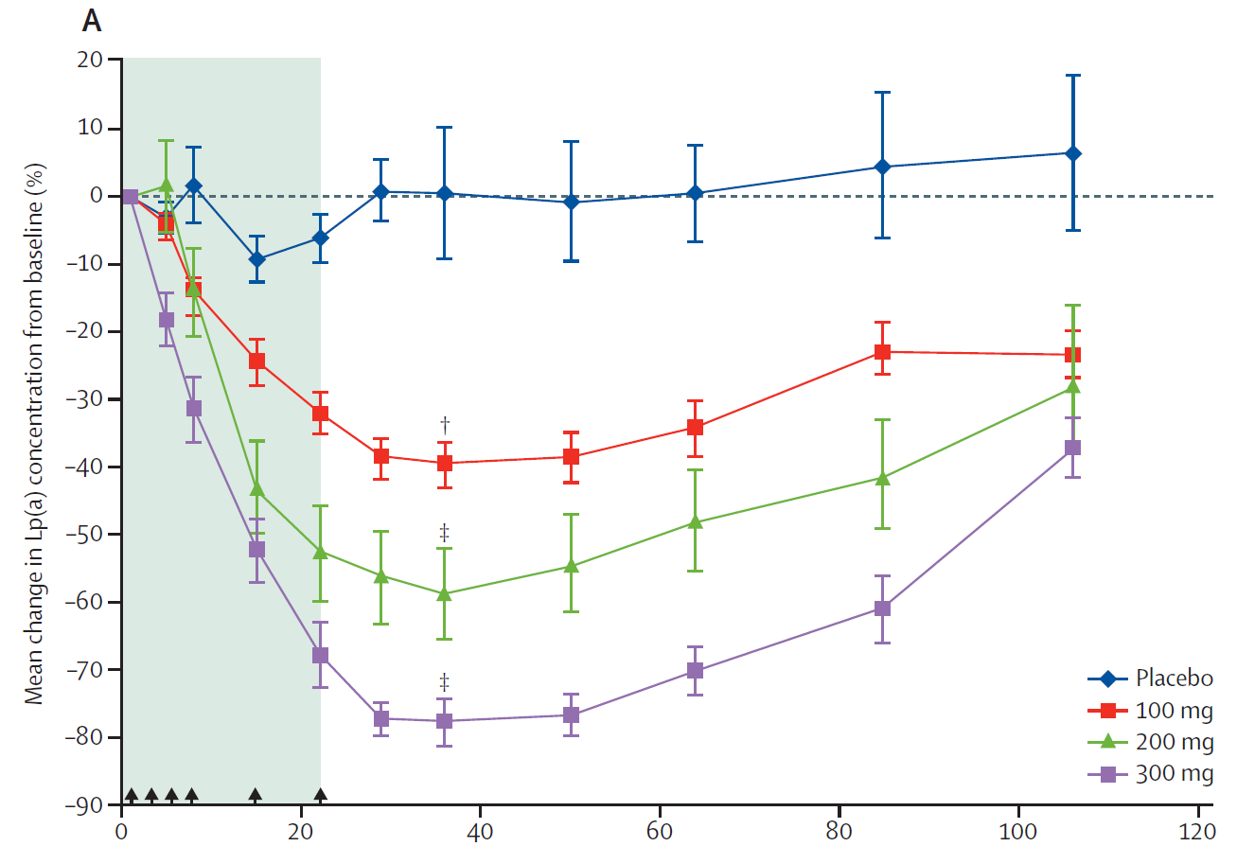
Lipoprotein (a): měření jednou za život a nové terapeutické možnosti (pelacarsen, ASO)
Vrablík et al. Atheroreview 2019
Tsimikas, Lancet 2015

Slide 20
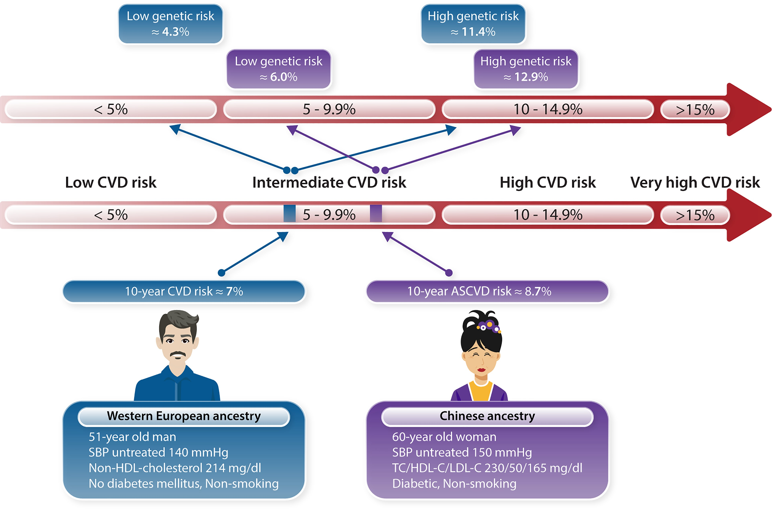

Polygenní rizikové skóre má prediktivní hodnotu
Notes:
Graphical Abstract The figure shows two individuals with their risk profile and predicted 10-year CVD risk (lower arrow). The predicted CVD risk is based on SCORE2 (the European man)15 and the recalibrated China-PAR model for ASCVD (Chinese woman).9 A low (bottom 20%) or high (top 20%) PRS may shift risk into neighbouring categories (upper arrow). The thresholds for risk categories and medical treatment differ slightly between the Chinese (used in the figure) and European guidelines. Risk estimates are based on Chinese10 and European (UK Biobank)6 datasets. Effects of the PRS on CVD risk may differ between populations, given the differences in the genetic architecture of the diseases and the fact that stroke is relatively more prevalent in individuals with East Asian ancestry as compared with Europeans. This highlights that neither risk prediction by traditional cardiovascular risk algorithms nor risk prediction by a CVD PRS can simply be transferred across populations. The impact of PRS may be more pronounced if the outer 5% of the distribution curve is considered.
Unless provided in the caption above, the following copyright applies to the content of this slide: © The Author(s) 2022. Published by Oxford University Press on behalf of European Society of Cardiology. All rights reserved. For permissions, please e-mail: journals.permissions@oup.comThis article is published and distributed under the terms of the Oxford University Press, Standard Journals Publication Model (https://academic.oup.com/journals/pages/open_access/funder_policies/chorus/standard_publication_model)© The Author(s) 2022. Published by Oxford University Press on behalf of European Society of Cardiology. All rights reserved. For permissions, please e-mail: journals.permissions@oup.com

Slide 21
Co (ne)budeme potřebovat od laboratoře pro stanovení rizika ASKVO ?
Celkový cholesterol nahrazen non-HDL-C
Zásadní význam stanovení koncentrace apolipoproteinu B
Přímé stanovení LDL-C zejména u léčených k velmi nízkým hladinám LDL-C
Stanovení hladiny lipoproteinu (a)
  nmol/l vs. mg/dl vs. g/l
Polygenní KV rizikové skóre posouvá riziko v každé úrovni přibližně 3x
  Nejzásadnější je u velmi vysoce rizikových
Rutinní vyšetřování nových biomarkerů se nedoporučuje

