Slide 1


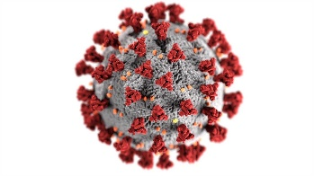


COVID-19: první pandemie ve 21. století a nové výzvy pro červené biotechnologie
Sympozium klinické biochemie
FONS 2022
18. – 20. 9. 2022
Libor Grubhoffer
Biology Centre of the Czech Academy of Sciences
České Budějovice

Slide 2
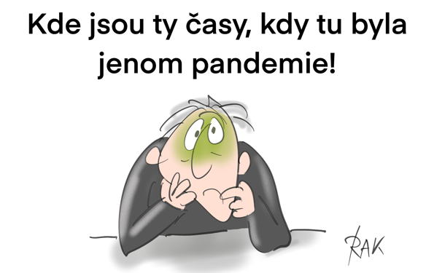


Slide 3

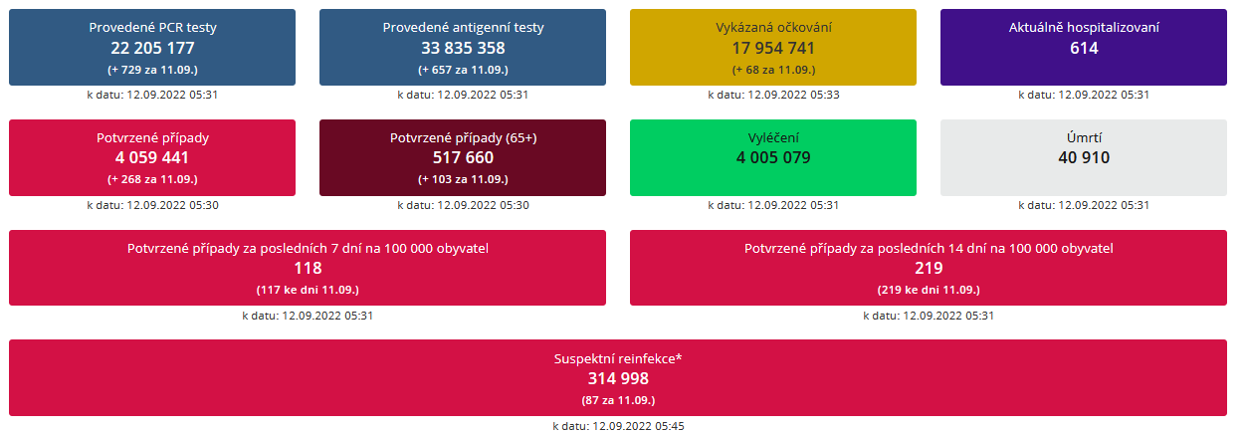

Zdroj: https://onemocneni-aktualne.mzcr.cz/covid-19

Slide 4
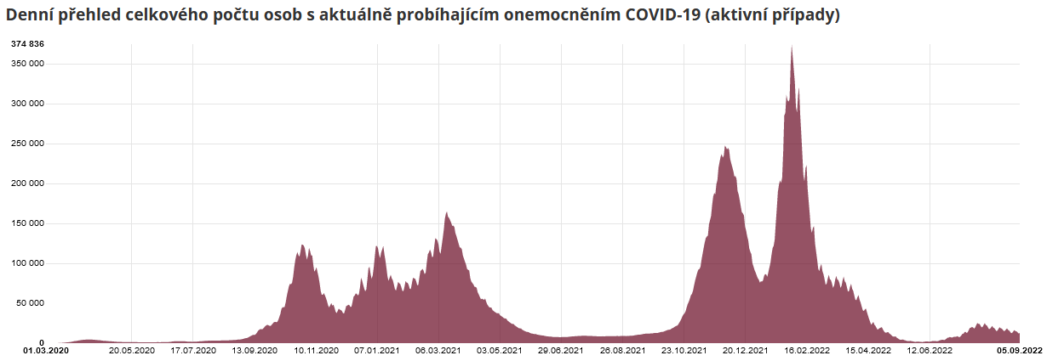
Zdroj: https://onemocneni-aktualne.mzcr.cz/covid-19

Slide 5
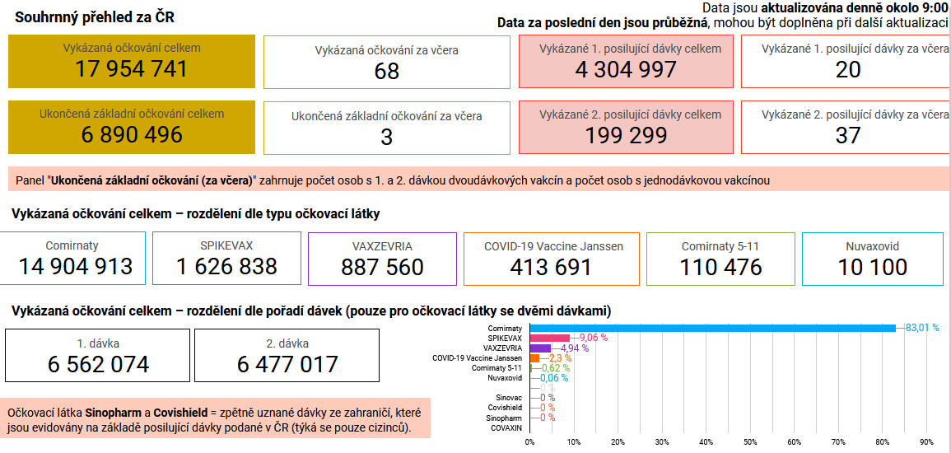
Zdroj: https://onemocneni-aktualne.mzcr.cz/covid-19

Slide 6

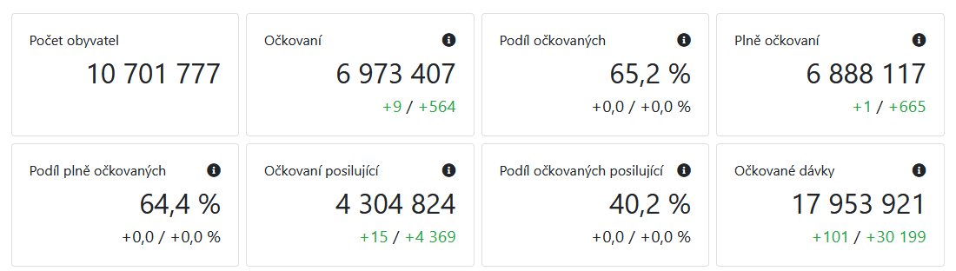
Očkování v ČR
K 12. 9. 2022 bylo kompletně naočkováno 6 888 117 lidí (64,4 %, 68,0 % starších 5 let) a 6 973 407 lidí (65,2 %, 68,8 % starších 5 let) alespoň jednou dávkou. Celkem bylo podáno 17 953 921 dávek.
Zdroj: https://ockovani.opendatalab.cz/statistiky

Slide 7


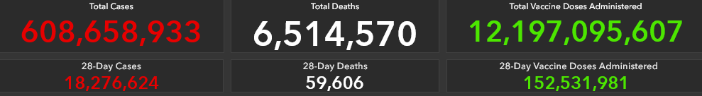
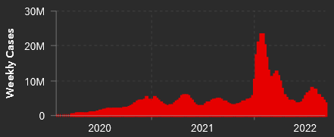
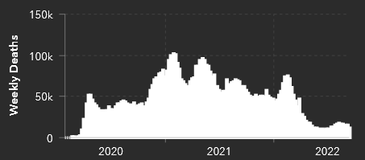
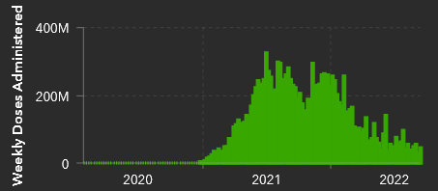
Zdroj: https://coronavirus.jhu.edu/map.html

Slide 8
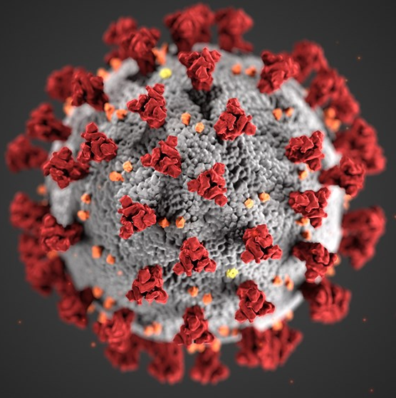
SARS-CoV-2
Coronaviridae
Betacoronavirinae
Size: up to 200nm
+ssRNA
Genome size: ~ 29.7kb
2/3 of the genome: NSp 1-16 (RTC)
1/3 of the genome:
4 structural proteins: S; E; M; N
8 orf3 – orf9 accompanying proteins of unknown function
NSp15: proofreading endonuclease

Slide 9
Zpráva ředitele BC
Libor Grubhoffer
zasedání Dozorčí rady BC,
18. 6. 2020

Slide 10
Zpráva ředitele BC
Libor Grubhoffer
zasedání Dozorčí rady BC,
18. 6. 2020

Slide 11

Významné varianty a mutace SARS-CoV-2
Varianta B.1.1.7 (α UK) = alfa
Varianta B.1.351 / 501.V2 (β JAR) = beta
Varianta P.1 / 501Y.V3 (γ Brazílie) = gama
Varianta B.1.525 (η Nigérie, UK) = éta
Varianta C.37 (λ Peru) = lambda
Varianta B.1.427 + B.1.429 (ε Kalifornie) = epsilon
Varianta B.1.617 (δ Indie) = delta
Varianta B.1.1.529 (ο dle WHO) = omikron
Subvarianty BA.1;BA1.2.212;BA.2;BA.3;BA.4;BA.5
deltacron

Slide 12
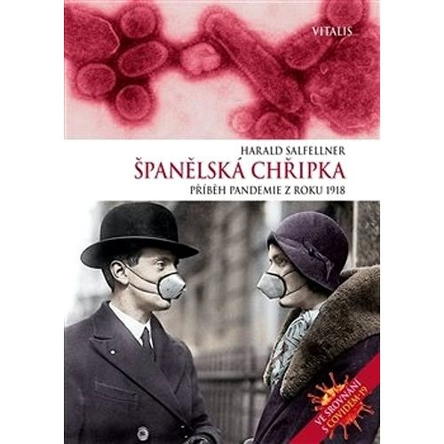
Covid-19 vaccines: how immunity is done during a pandemic
By wildly spreadinfection
Spanish Influenza 19 - 1920
(Pfeifer's bacillus; 1933/34 Discovery of Influenza virus: W. Smith, Ch. Andrewes, P. Laidlaw)
By immunization with vaccines
Smallpox, polio, measles, yellow fever, ...

Slide 13
Influenza pandemics
1918 – 1920: Spain flu
Strains of A/H1N1
500 million infections (estimated)
Deaths 25–50 million (generally accepted), other estimates from 17 to 100 million
2nd deadliest pandemic ever after the Black Death bubonic plague of 1346–1353
1957–1958: Asian flu
Strains of A/H2N2
Deaths 1–4 million
1968-1969: Hong Kong flu
Strain A/H3N2 (originated from H2N2)
Deaths 1–4 million

Slide 14
Influenza pandemics
1977-1979: Russian flu
Strain A/H1N1 (1946; 1957)
Deaths 700,000
2009: Swine flu
Strain A/H1N1
Resulted from a triple reassortment of bird, swine, and human flu viruses which further combined with a Eurasian pig flu virus
Deaths: 284,000 (range from 150,000 to 575,000)
WHO estimates: 250,000 to 500,000 deaths from seasonal flu annually

Slide 15
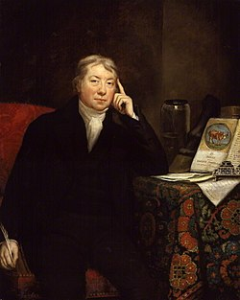
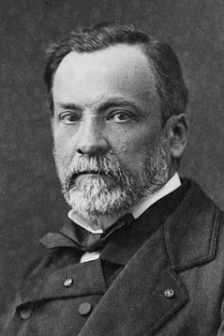
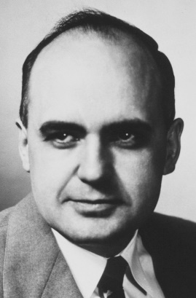
Vaccines: The Greatest Benefit to Mankind
(Roy Porter: A Medical History of Humanity from Antiquity to the Present, Czech Edition, Prague, 2001)
Edward Jenner (1749 - 1823)
Smallpox vaccine
Louis Pasteur (1822 - 1895)
Anthrax vaccine; Rabies vaccine
Maurice Hilleman (1919 - 2005)
over 40 viral antibacterial vaccines (Bristol-Meyrs Squibb; Merck&Co.)
most successful: meales, mumps, hepatitis A, hepatitis B, chickenpox, Neisseria meningitis, Streptococcus pneumoniae, Haemophilus influenzae; 1957-1958 Asian flu pandemic

Slide 16
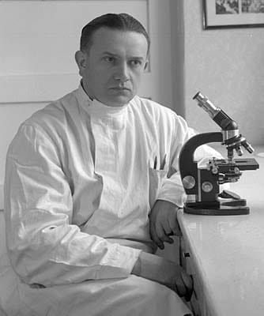
prof. MUDr. Karel Raška, DrSc. (1909 - 1987)
How the world defeated smallpox.
A historical story for waiting for the covid vaccine

Slide 17
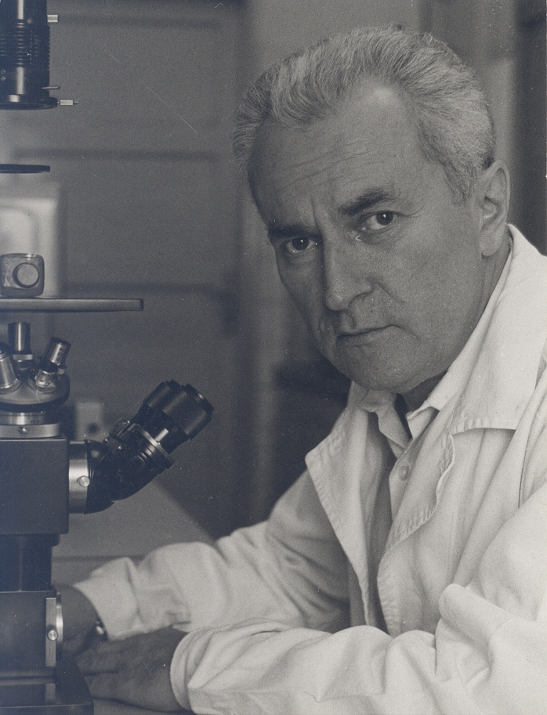
doc. MUDr. Dimitrij Slonim (1925 - 2017)
Vaccines implemented:
Polio (Salk; Sabin); Smallpox Measles; Mumps
Unrealized vaccines:
Rabies; Tick-borne Encephalitis

Slide 18
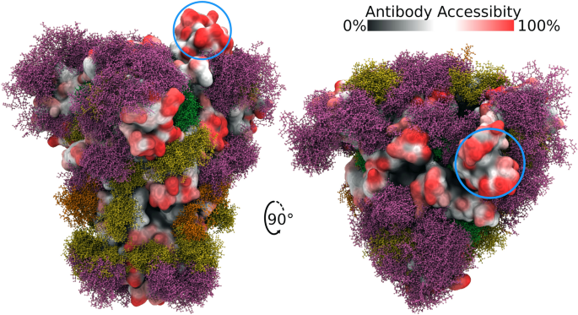
Spike glycoprotein S
https://www.nature.com/articles/s41598-020-71748-7
Spike S: heterotrimer 3 x gpS = gp(S1 + S2)
S1 ACE2 receptor (Angiotensin Converting Enzyme 2)
S2 Fusion factor (activated by TMPRSS2 – Transmembrane Serine Protease)

Slide 19
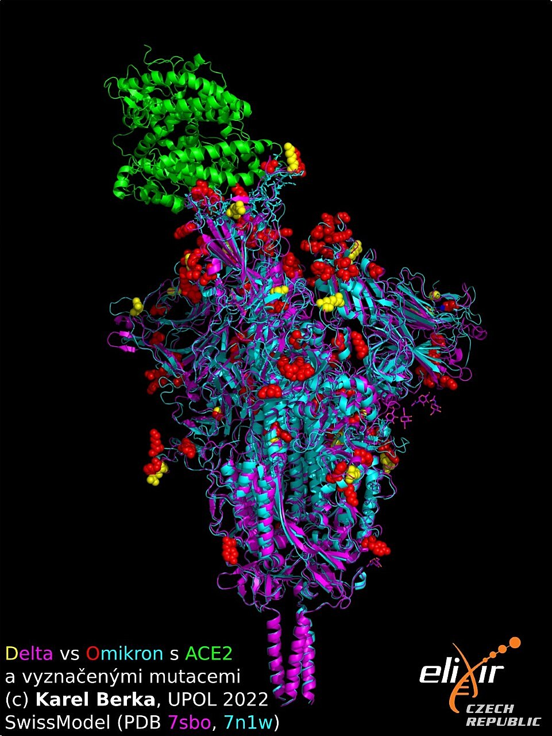
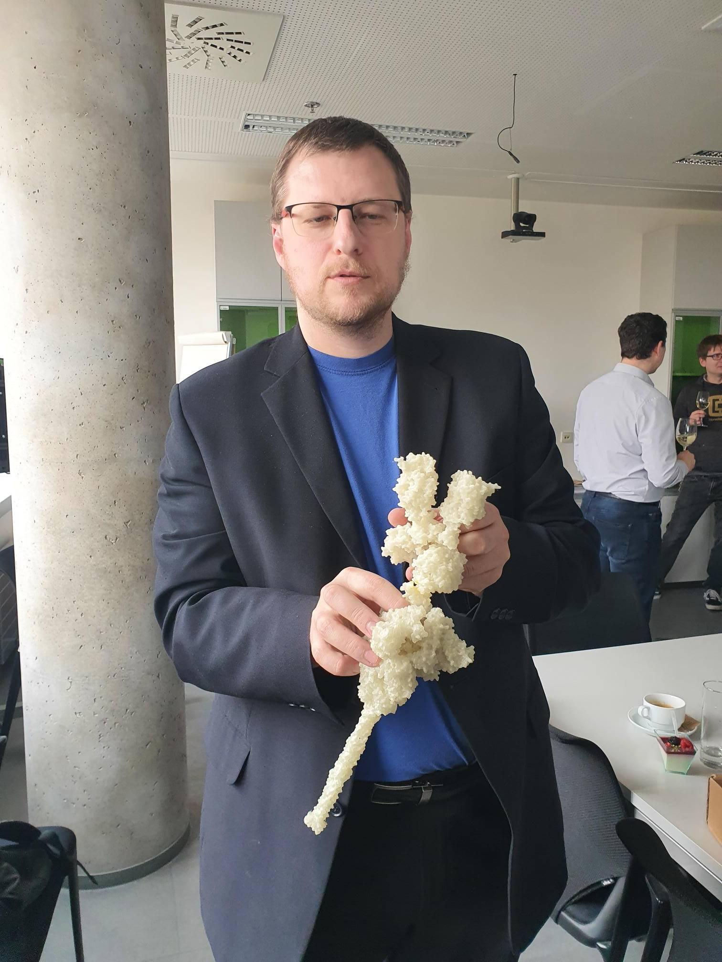
Doc. Karel Berka, UPOL

Slide 20
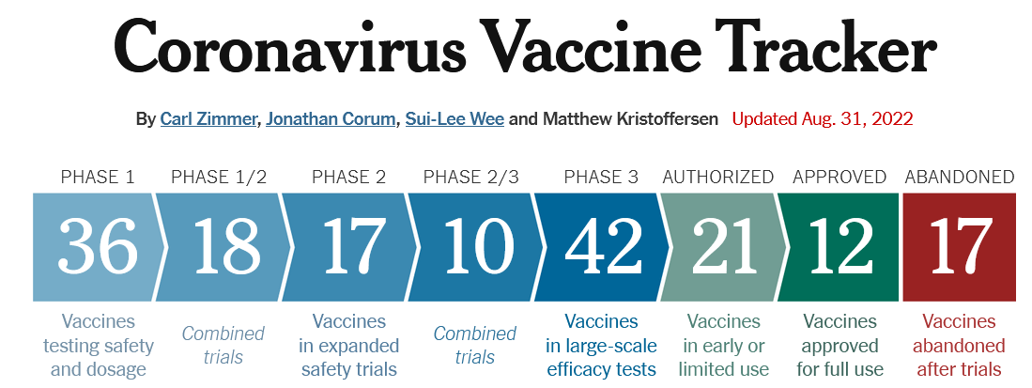
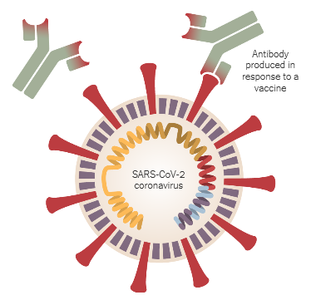
Operation Warp Speed (D. Trump); COVAX, the vaccines pillar of the Access to COVID-19 Tools (ACT) Accelerator;

Slide 21
Zpráva ředitele BC
Libor Grubhoffer
zasedání Dozorčí rady BC,
18. 6. 2020

Slide 22
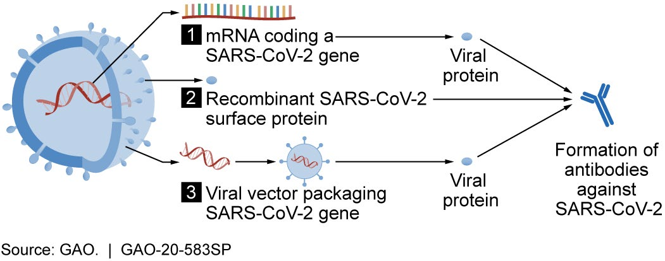
Biotechnology platform of modern vaccine
Genetic (Gene) RNA/DNA vaccines
Viral vector vaccines
Recombinant protein vaccines

Slide 23
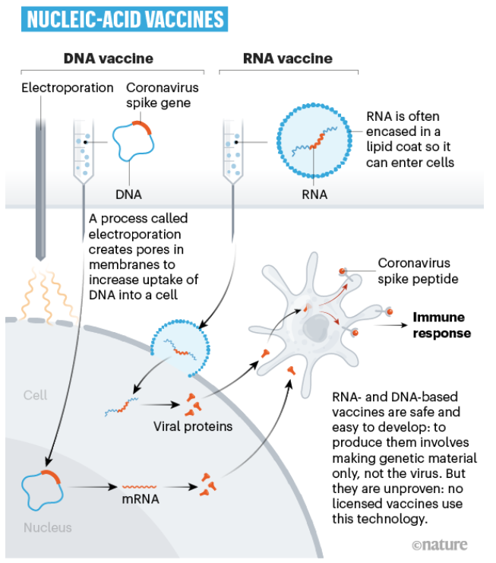
Katalin Karikó (1989)
Drew Weismann (2005)

Slide 24
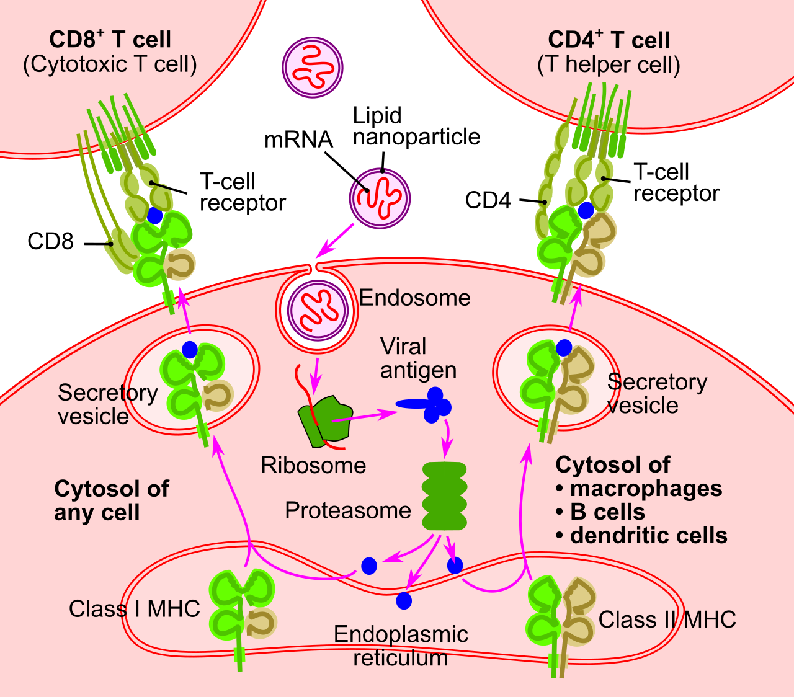
Genetic mRNA vaccine
Rainer H. Mϋller & Pieter Cullis
(LDL lipid nanoparticle)

Slide 25
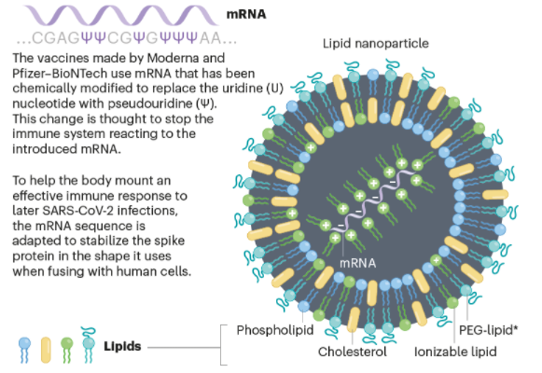
M. D. Buschmann a kol. Vaccines 9, 65 (2021)

Slide 26
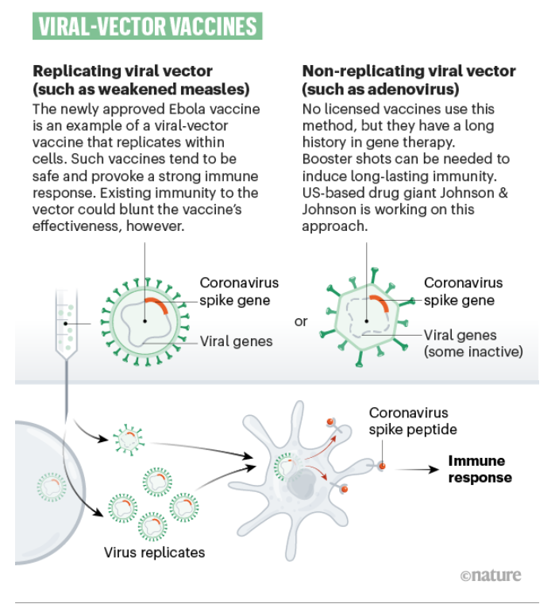

Slide 27
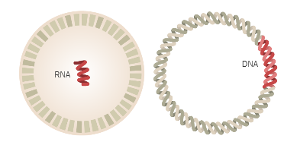
Genetic Vaccines (13x)
Zpráva ředitele BC
Libor Grubhoffer
zasedání Dozorčí rady BC,
18. 6. 2020
6x
7x

Slide 28


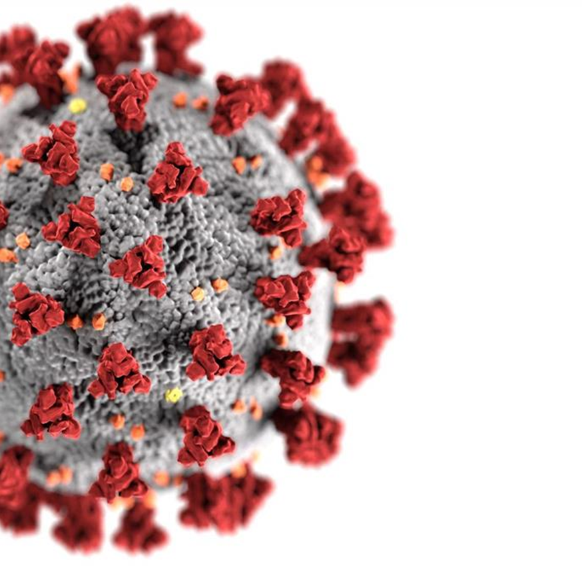
The German company BioNTech entered into collaborations with Pfizer and the Chinese drug maker Fosun Pharma to develop an mRNA vaccine.
(Comirnaty; TOZINAMERAN)
Zpráva ředitele BC
Libor Grubhoffer
zasedání Dozorčí rady BC,
18. 6. 2020
Urgur Sahin & Őzlem Türeci

Slide 29


Moderna developed vaccines based on messenger RNA (mRNA) to produce viral proteins in the body. (mRNA-1273)
SPIKEVAX
Zpráva ředitele BC
Libor Grubhoffer
zasedání Dozorčí rady BC,
18. 6. 2020
Derrick Rossi

Slide 30
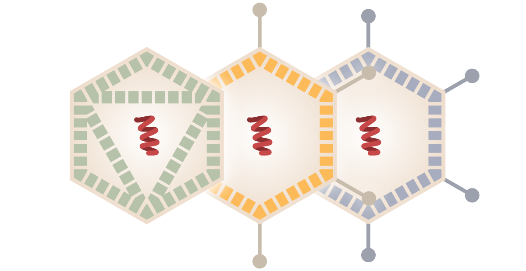
Viral Vector Vaccines (19x)
Zpráva ředitele BC
Libor Grubhoffer
zasedání Dozorčí rady BC,
18. 6. 2020

Slide 31

A vaccine in development by the British-Swedish company AstraZeneca and the University of Oxford is based on a chimpanzee adenovirus called ChAdOx1.
(AZD1222; Vaxzevria)
Replication-deficient siamian adenovirus vector containg full lenght codon-optimized coding sequence of SARS-CoV-2 spike S protein + tissue plasminogen activator (tPA) leader sequence

Slide 32

Sputnik V
Gamaleya Research Institute of Epidemiology & Microbiology launched a vaccine named Gam-Covid-Vac Lyo. It is a combination of two adenoviruses, Ad5 and Ad26, both engineered with a coronavirus spike S gene.
Zpráva ředitele BC
Libor Grubhoffer
zasedání Dozorčí rady BC,
18. 6. 2020

Slide 33


Janssen Pharmaceutica
Beth Israel Deaconess Medical Center in Boston developed a method for making vaccines out of a virus called Adenorivus 26 (Ad26), 2010. Johnson & Johnson developed vaccines for Ebola and other diseases with Ad26 – for Covid-19
(Ad2b.CoV2.S)
Zpráva ředitele BC
Libor Grubhoffer
zasedání Dozorčí rady BC,
18. 6. 2020

Slide 34

Protein-Based Vaccines (3x; 42x)
Zpráva ředitele BC
Libor Grubhoffer
zasedání Dozorčí rady BC,
18. 6. 2020

Slide 35
(Praha Vaccines), Novavax CZ
Novavax (MD, USA) created the COVID-19 vaccine candidates using its recombinant protein nanoparticle technology platform to generate antigens derived from the coronavirus spike (S) protein expressed stabily in a baculovirus system (insect cells). Novavax uses proprietary saponin-based Matrix-M adjuvant with its COVID-19 vaccine to enhance immune responses (presentation in local lymph nodes). Sweden, Czech Republic - Bohumil/Jevany), Germany.
NUVAXOVID
.
Zpráva ředitele BC
Libor Grubhoffer
zasedání Dozorčí rady BC,
18. 6. 2020

Slide 36
EpiVacCorona - coronavirus vaccine, VECTOR Koltsevo
.
Zpráva ředitele BC
Libor Grubhoffer
zasedání Dozorčí rady BC,
18. 6. 2020

Slide 37


In addition to their mRNA vaccine, Sanofi is developing a vaccine based on viral proteins. They are producing the proteins with engineered viruses that grow inside insect cells. GSK will supplement these proteins with adjuvants that stimulate the immune system. Phase 3 clinical trial
.
Zpráva ředitele BC
Libor Grubhoffer
zasedání Dozorčí rady BC,
18. 6. 2020

Slide 38
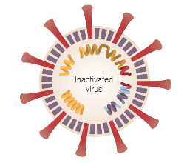
Whole-Virus Vaccines
Zpráva ředitele BC
Libor Grubhoffer
zasedání Dozorčí rady BC,
18. 6. 2020
Inactivated or Attenuated

Slide 39






(CoronaVac)
(BBIP-CoV)
Zpráva ředitele BC
Libor Grubhoffer
zasedání Dozorčí rady BC,
18. 6. 2020
(BBV 152; Covaxin)

Slide 40
Zpráva ředitele BC
Libor Grubhoffer
zasedání Dozorčí rady BC,
18. 6. 2020

Slide 41
Zpráva ředitele BC
Libor Grubhoffer
zasedání Dozorčí rady BC,
18. 6. 2020

Slide 42
Zpráva ředitele BC
Libor Grubhoffer
zasedání Dozorčí rady BC,
18. 6. 2020

Slide 43
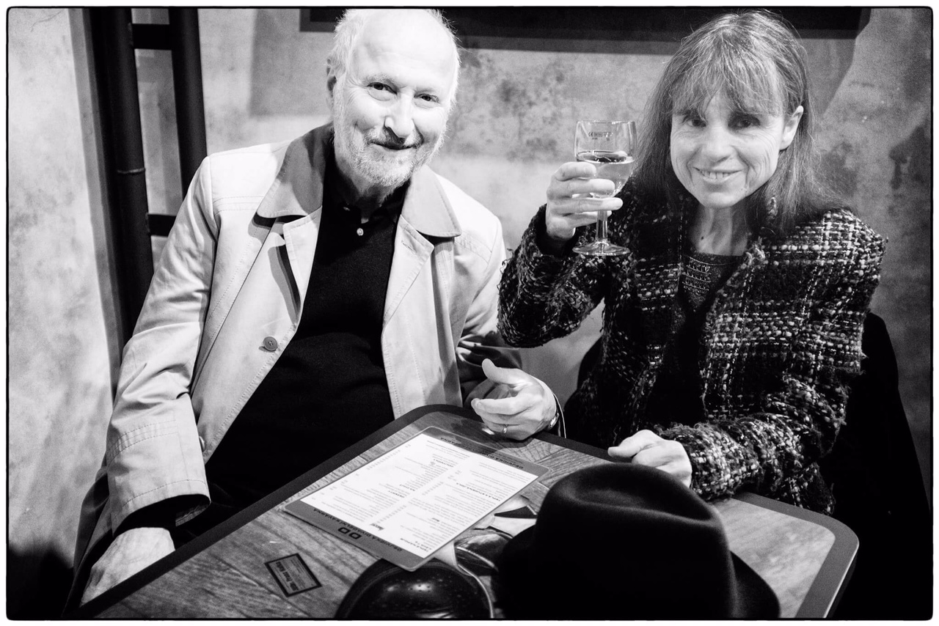
Thank you for your attention!
.
Libor Grubhoffer

